Slide 1
Compiler Design
Chapter 5
SYNTAX Directed translation
Dr. Sini Anna Alex

Slide 2
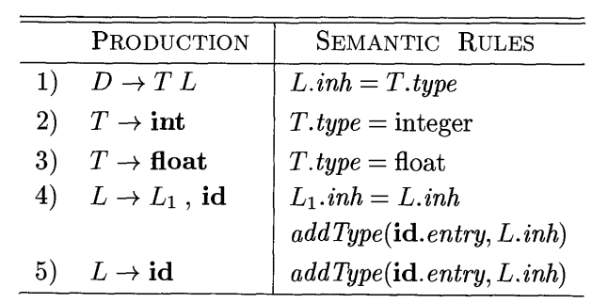
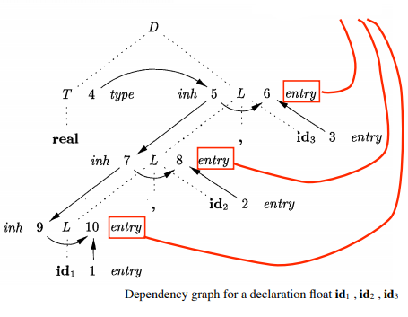
SDD for Simple Type Declarations
Symbol Table Interaction Nodes

Slide 3

Any SDD containing the following production and rules cannot be L-attributed

Slide 4
Applications of Syntax Directed Translation
Some compilers use syntax trees as an intermediate representation
- a common form turns the input string into a tree.
Construction of Syntax trees
Syntax Tree node representing E1+E2 has a label + and two children.
If Node is a Leaf, an additional field hold the lexical value for the leaf.
Constructor function Leaf(op, val)
If Node is an interior Node, Constructor function Node(op, c1, c2,c3….ck)

Slide 5
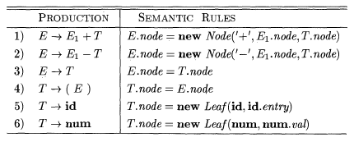
S-Attributed Definition for the construction of Syntax Trees

Slide 6
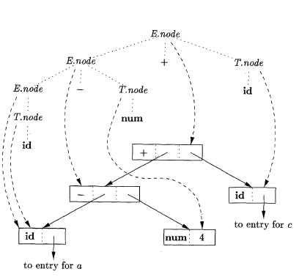
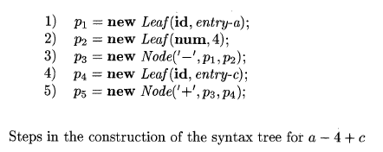
Syntax Tree for a-4+c

Slide 7
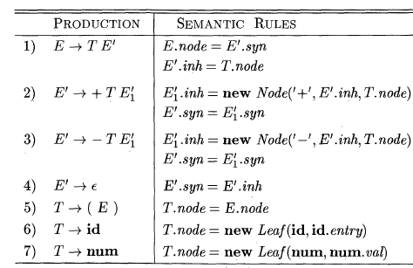
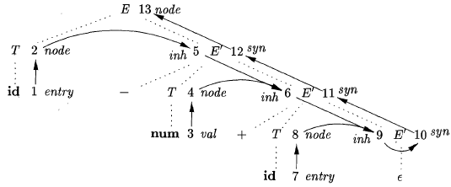
Construction of Syntax Tree for Top Down Parsing-L Attributed Definition
Dependency Graph for a-4+c

Slide 8
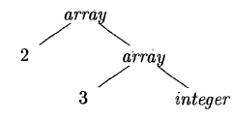
The Structure of a Type
In C, the type int[2][3] can be read as, “array of 2 arrays of 3 integers”
Type expression for int[2][3]
The operator array takes two parameters, a number and a type.

Slide 9
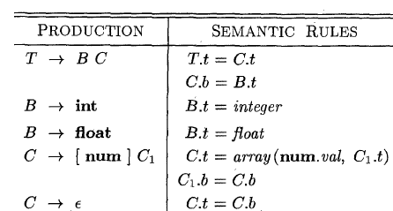

T generates either a basic type or an array type
T.T and C.t -synthesized

